Slide 1


The Power of
AUDIO
2026
www.radiocbs.com

Slide 2

73% of listeners strongly agree radio’s primary advantage is its local feel
www.radiocbs.com
Notes:
Source: RTS Canada Fall 2024 – A18+; Question: community news/local events important OR radio feels more personal

Slide 3
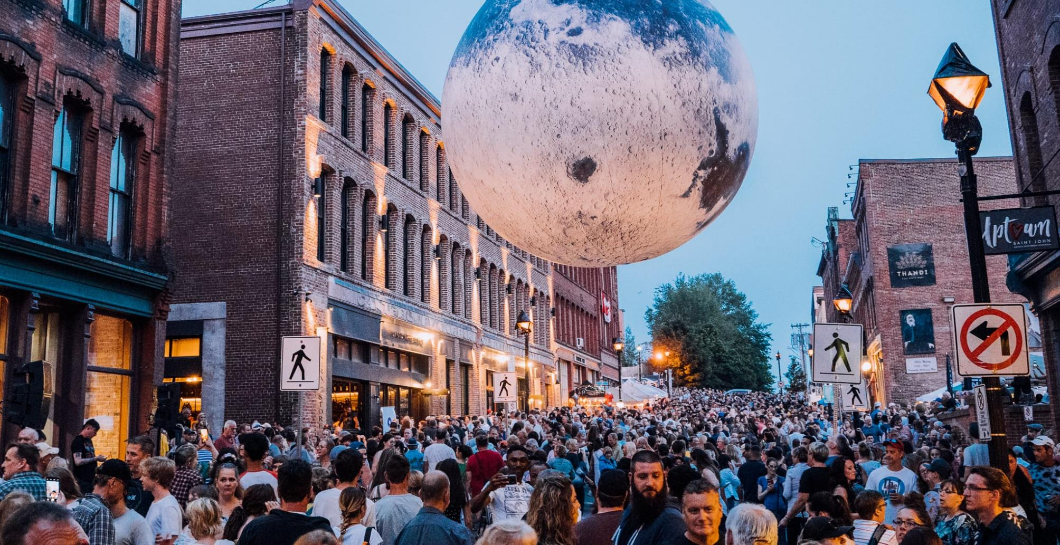
77% feel their local radio personalities understand what makes their town unique
www.radiocbs.com
Notes:
Source: Jacobs Media Tech Survey 2024
Broadcast radio’s “connectivity” and “local-ness” set it apart from podcasts, DSPs, and personal music collections. And both rise in importance again this year.
Radio Listeners Feel a Strong Sense of Connection to Their Station and Hosts (agree/strongly agree) = 77%

Slide 4
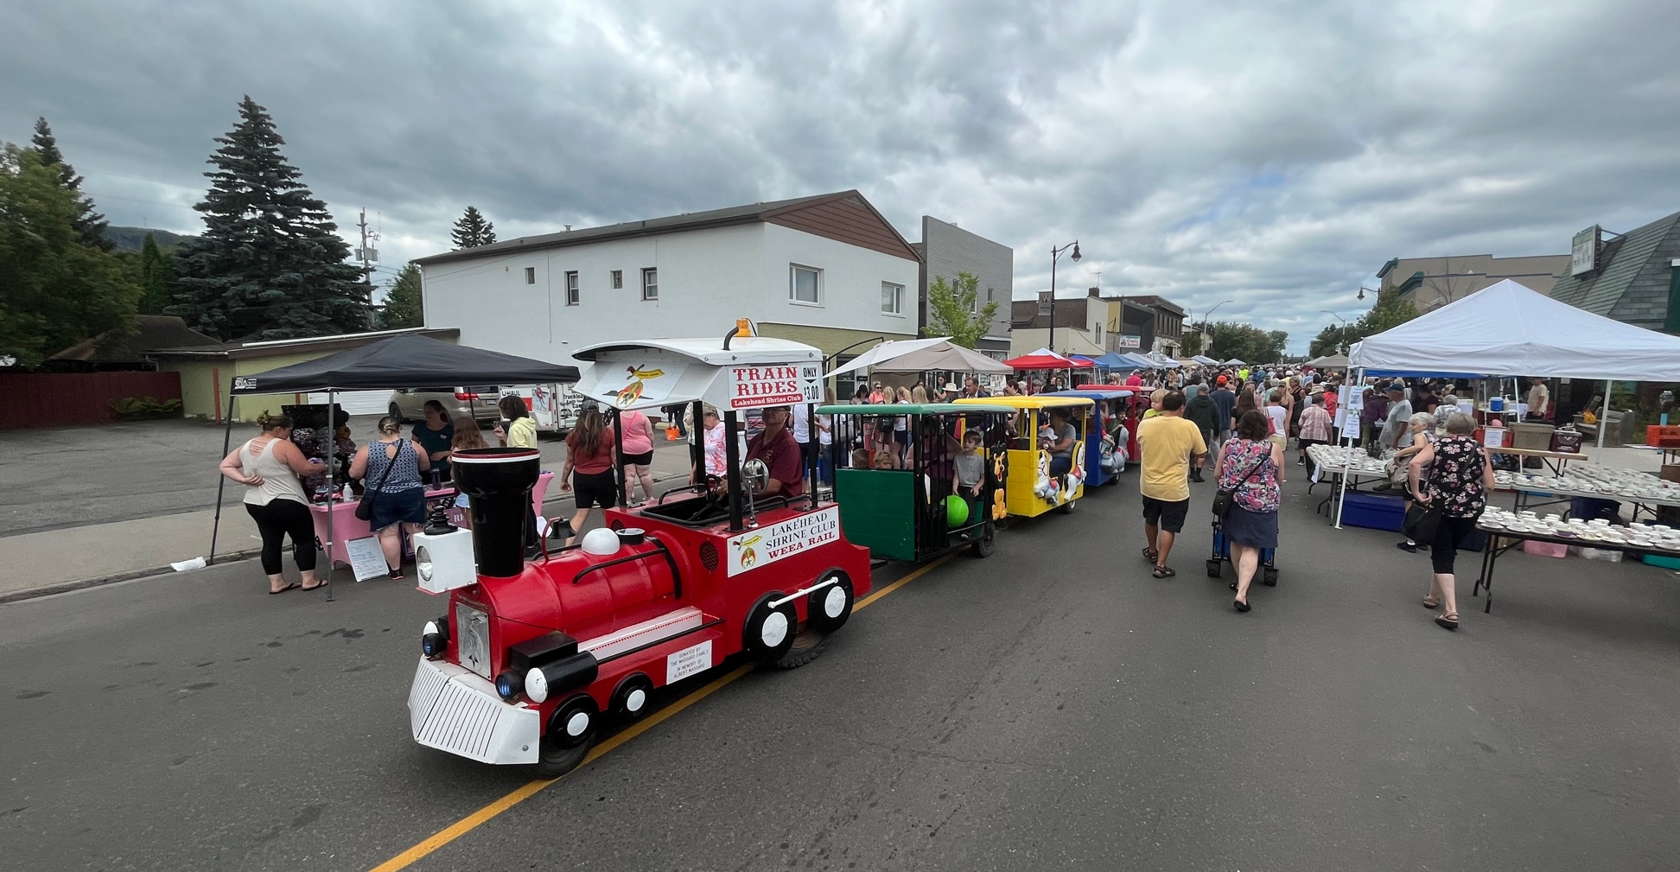
Radio entertains, informs, and shapes local communities, influencing opinions and consumer behaviour.
www.radiocbs.com
Notes:
In a world saturated with countless media options, radio's enduring connection with listeners stands as a testament to its power and influence. Radio not only entertains and informs, but it reaches into the very heart of local communities, shaping opinions and driving consumer behavior.

Slide 5
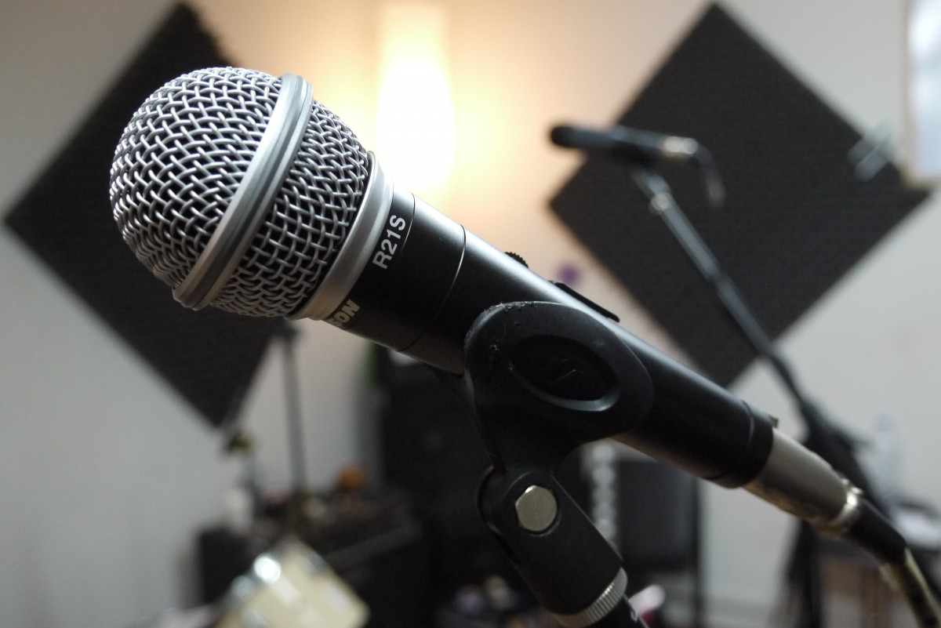
How do CONSUMERS listen to AUDIO
“‘Real Radio’ is still defined for me by doing what a playlist cannot do—putting together music in an order that is different each time, but ot random; telling me what’s happening in my town, or yours; advocating for the music it introduces to me; being punctuated by people who are funny or thought-provoking. Part of the initial appeal when I began listening, and part of radio’s identifying DNA now, is the shared experience.”
Sean Ross, VP Music and Programming, Edison Research
Radio is "an audio-first shared experience with a human connection.”
www.radiocbs.com

Slide 6






A DAY IN THE LIFE OF AN AUDIO CONSUMER
7AM
AM/FM radio
12PM
online streaming
5PM
AM/FM radio
7PM
streaming
11PM
podcast
Listen in the car commuting to work “to hear local news, traffic and weather to be informed and “radio is easy to listen to while driving.”
Stream radio online with headphones while working to “stay connected and focused.”
Listen to radio commuting back home.
Listen to radio to through smart speaker while doing errands at home and help wind down.
Listen to audio books or podcasts through smart speaker or headphones to “help with sleep.”
Weekly Hours in Diary Markets
Source: Numeris PPM R01 2024; Average Weekly Cume %
Notes:
Source: Rogers Sight Sound and Motion 2025

Slide 7


Canadians spend 14 hours per week with radio
Weekly Hours Spent with Audio
2 Hrs Free Music
1.9 Hrs AM/FM Streamed
29 Hours/Week
19 Hours/Week
12 Hours/Week
7 Hours/Week
2.6 Hrs Podcast
Total Audio
Ad-Supported Audio
AM/FM Radio
Digital Audio
Notes:
KEY NOTES:
…. Canadians have a diverse range of ways to consume audio and on average spend more than 29 hours per week with audio. Of that, 35% is spent on non-commercial platforms. They spend 19 hours a week of listening to ad-supported audio.
Of that 19 hours a week, almost exactly 2/3’s is traditional Over the Air radio, and 1/3 is ad-supported digital platforms. And, 7 hours per week of digital audio listening across 3 platforms.
Out of the total 29 hours spent on audio, once we remove non-ad-supported content like personal music, 19 hours, or 65%, remain as ad-supported audio time. Of those 19 hours, 12 are spent on linear radio, and the remaining 7 are split across digital audio, including streamed radio, podcasts, and on-demand music streaming.
**Calculation of Average Weekly hours spent**
Total Audio Tuning: 14.1 / 49% = 28.8 ≈ 29 hours/week
Live Radio (49%) = 14.1 hours, broken down into:
OTA: 87% = 12.2 hours
Streaming: 13% = 1.9 hours
Personal Music (incl. paid streaming): 35% = 10.1 hours
Podcasts: 9% = 2.6 hours
Free/Ad-supported Music Streaming: 7% = 2.0 hours
Source:
Signal Hill Insights – Radio On the Move Fall 2023 – Source of audio listening for Canadian A18+ in % Share.
Numeris RTS Canada Fall 2024: Weekly Time spend on Radio: 14.1 hours
Numeris PPM R1/2025: Split of OTA / Streaming of AM/FM Radio, Reach Plan. A18+ = 87% : 13%

Slide 8

82%
of Canadians work away from home part of the week
51% WORK FROM HOME 3+ DAYS PER WEEK
14% WORK HYBRID & 17% PRIMARILY WORK FROM HOME
Notes:
Source: The Harris Poll Canada panel of 3,000 Canadians 18+, Fall 2024 Source:: The Harris Poll Canada panel of 3,000 Canadians 18+, Fall 2024
The perception is — everyone is working remote now and the reality is that 83% are working away from home for at least part of the week.

Slide 9

81%
of Canadians travel to work by car
…continuing a steady shift away from remote work
Notes:
Source: Statistics Canada Labour Force Study 2025

Slide 10


Two thirds of Canadians choose radio as their #1 in-car audio option.
48% of A18-49
40% of A25-34
ALSO CHOOSE RADIO AS THEIR #1
IN-CAR AUDIO OPTION
www.radiocbs.com
Notes:
Source: Numeris RTS Canada – Fall 2024, Base: Total A18+, Attributes – Important; Listen Most Often; Radio Audio Options In Car

Slide 11
What makes AUDIO so effective
www.radiocbs.com

Slide 12

Connecting with Canadians across all age groups
A18+
83%
A12-24
78%
A18-34
76%
A18-49
80%
A25-54
81%
A35-54
84%
A55+
87%
A35+
86%
www.radiocbs.com
Source: Numeris PPM R01 2024; Average Weekly Cume %
Notes:
KEY POINTS
Radio speaks to at least 8/10 Canadians every week
That is true for all demo across the board.
Total Meter Markets R03 2024 All Week 5a-1a

Slide 13








RADIO HAS THE LOWEST AD AVOIDANCE OF ALL MEDIA
59%
58%
55%
50%
Web Browsing
Social Media
Streaming Video
Television
47%
41%
42%
28%
Community
Newspapers
Radio
Newspapers
Magazines
www.radiocbs.com
Notes:
Source: RTS Canada Fall 2024 – A18+; Question: Frequently Avoid Ads

Slide 14






RADIO BEATS ALL AUDIO PLATFORMS
Reach more Canadians with AM/FM radio versus all other audio platforms
81%
21%
14%
12%
Radio
Paid Spotify (Ad Free)
Free YouTube Music
Free Spotify (Ad Supported)
10%
8%
5%
4%
Stingray Music Channels
Amazon Prime Music
Paid YouTube Music
Apple Music
www.radiocbs.com
Notes:
Source: RTS Canada Fall 2024 – A18+; Question: Radio Online Media App/Sites used past 7 days/ Radio Reach Numeris Total Meter R03 2025 Avg Weekly Cume %
Radio is the #1 audio platform to reach Canadians with an advertising message

Slide 15

RADIO ADS ARE TRUSTED BY CANADIANS
Online Music Streaming (Spotify with Ads)
RADIO
(OTA or Streamed)
Print/Newspaper or Magazines
OOH (Billboards, Transit, Poster)
Cable TV
Direct Mail
Email Advertising
Social Media (FB, Tik Tok, X)
Video/Mobile Games
Cinema
TV/Movie Streaming
Podcasts
You Tube
Online Banner Ads
Online Pop-Up Ads
www.radiocbs.com
Notes:
Source: RadioConnects Audio Update 2025.
Local Importance: How much do you agree or disagree with the following statements?
Ad Perceptions: For each of the following media, please select whether or not the advertising you would expect to find there would be trustworthy Base: Canadians 18+
On top of connecting with all age groups, cost effectivenesss and the Cognitive, Emotional response, radio is a trusted medium.
Here we have one of the most compelling points of Radioconnects audio update 2025; In terms of ad perception, radio is the most trusted media.
While social media and YouTube for instance, are experiencing a significant drop.
What's particularly notable is the performance of digital and social platforms. Trust in advertising on platforms like Social Media (at 49%) and YouTube (at 39%) drops significantly.

Slide 16

AUDIO
IMPACT FOR BRANDS
www.radiocbs.com

Slide 17
Audio drives impact at every stage of the purchase funnel
Percentage of U.S. Adults Impacted by Advertising
 | RADIO | TV | TIK TOK | FACEBOOK | IG | BVOD | ONLINE VIDEO | OOH
AWARENESS | 58% | 62% | 39% | 52% | 46% | 40% | 47% | 50%
CONSIDERATION | 48% | 52% | 36% | 43% | 41% | 34% | 39% | 40%
CONVERSION | 54% | 58% | 38% | 49% | 44% | 37% | 44% | 47%
LOYALTY | 42% | 47% | 31% | 38% | 36% | 30% | 36% | 36%
www.radiocbs.com
Notes:
KEY NOTES:
…it sure does. Radio ranks in the top 2 for awareness, consideration, conversion and loyalty. Showing us that audio shines all the way through the funnel from the upper funnel (first stop on the shopper journey); mid funnel (the shopper’s consideration or kick the tires stage) and the lower funnel where the rubber meets the road – the shopper decision stage.
Source: Audacy Fuel the Funnel - 2023

Slide 18


Audio elicits
56% higher attention
&
conversion with more time ads are heard
attention = sales
Dentsu Attentiveness Study 2023 and Mindshare Audio Study 2023
www.radiocbs.com
Notes:
KEY POINTS:
Dentsu's research showed us that audio ads elicit 56% higher attention, and Increased attention scores are associated with +10% improved brand preference. *Important note - the Denstu study dispelled the myth that sight, sound and motion ads are superior to audio only ads

Slide 19


12% higher emotional intensity
&
emotional intensity =
brand favourability
and pricing power
www.radiocbs.com
Notes:
KEY POINTS:
Mindshare went on to also conduct their own research that proved that audio ads create Emotional intensity which builds brand affinity compared to other alternative platforms (+12%)
Emotional intensity (+12%) is associated with brand favourability and pricing power.
Source:Mindshare Audio Study 2023

Slide 20







+8% higher level of brand recall
=
mental availability for brand messaging
www.radiocbs.com
Notes:
Source: Brainsights is a Canadian company and a world leader in neuro-marketing measurement. Brainsights analyses human reactions to advertising, by recording neural activity through EEG technology.
Radio outperforms both Television and Digital when it comes to Encoding and memorability
Radio Memory structures creation leads to +8% higher level of brand recall.

Slide 21











NIELSEN CONFIRMS RADIO DELIVERS TOP-TIER ROI
Social
Radio
TV
Print
Connected TV
Video
Display
Podcasts
OOH
Search
$2.22
$2.00
$1.56
$1.52
$1.49
$1.47
$1.47
$1.33
$1.16
$1.15
Notes:
Nielsen Global Annual Marketing Survey 2025, Nielsen Global Compass Media Mix Modeling benchmarks demonstrates that radio is great value for advertisers. Issue is industry sees radio as lowest effective media yet in reality it ranks #2 against all other media.

Slide 22
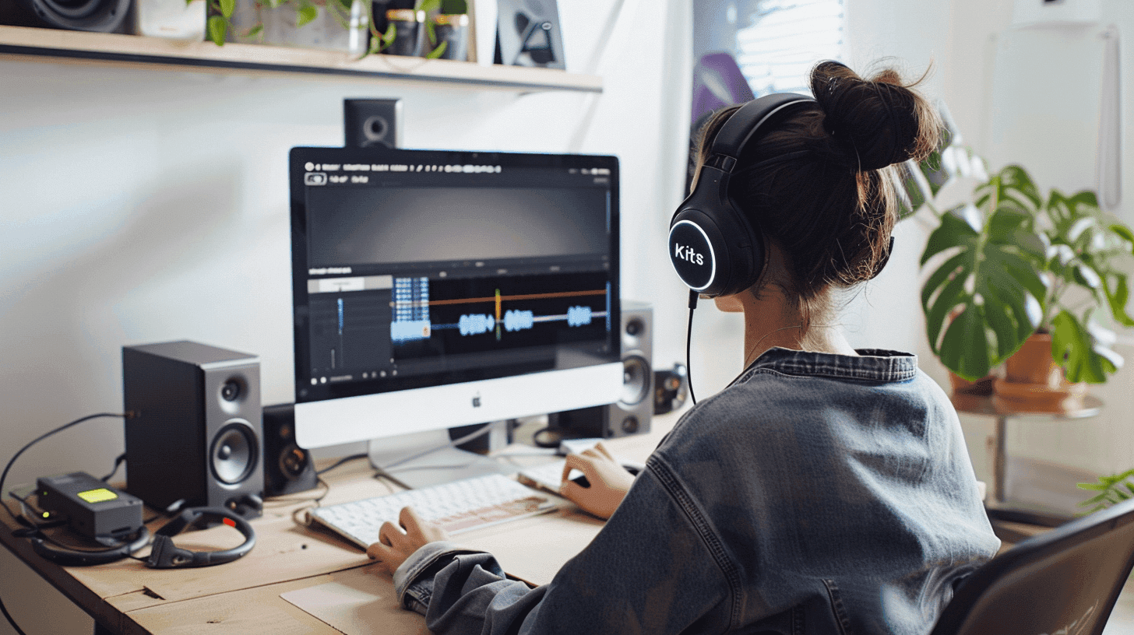







RADIO DELIVERS IT ALL
REACH
Reaches wide and diverse audience, an effective medium for mass communication.
TRUST
High levels of listener trust, audiences considering it a reliable source of information.
IMPACT
Strong cognitive impact, engaging imagination and enhancing message retention via audio.
COST
Offers a cost-effective advertising solution with a high ROI, maximizing marketing budgets.
w w w . r a d i o c b s . c o m

